Slide 1
WinRT and Windows 8
Sergey Barskiy
Principal Consultant, Magenic

Slide 2
Windows 8 and its runtime
Windows 8 is fully backwards compatible with Windows 7
Designed for current hardware and for ARM based tablets
Two kinds of apps
Traditional desktop applications (Win32 API)
New Windows Runtime (WinRT) Metro style applications

Slide 3
WinRT
New API on top of operating system
Modern, accounting for lessons learned
Heavily asynchronous

Slide 4
Traditional Apps
Look at PowerPoint
Chrome
Title bar
Status bar
Ribbon / menu

Slide 5
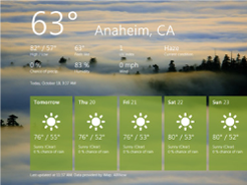
Metro Apps
No chrome / No menu
Full screen
A lot less busy
“Fast and fluid”
Touch ready, but works with keyboard and mouse

Slide 6
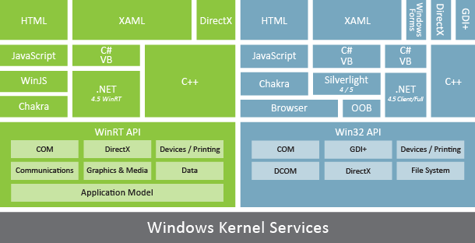
Windows 8 Technology Stack

Slide 7
Advantage of Metro “platform”
Sandbox (advantage you say?)
Simpler APIs
Asynchronous (mostly)
Accessible from all supported languages (yes, including HTML)
Access to hardware

Slide 8
Existing Apps
I have an existing app I would like to port to WinRT.
Lucky me?

Slide 9
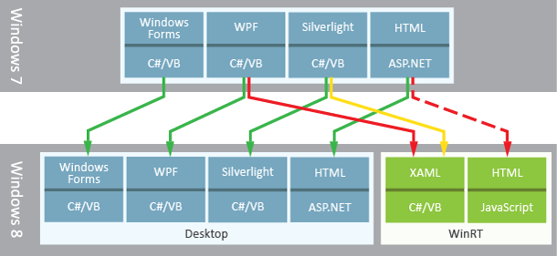
Windows 8 Conversions

Slide 10
Tools for Metro Apps
Visual Studio
Blend
Languages
C# / VB.NET
C++
HTML / CSS / JavaScript

Slide 11
Windows 8 Features for Developers
Share contracts
Tiles / notifications
Touch is first class citizen

Slide 12
Getting Started
Windows 8
Visual Studio Templates
Samples on MSDN

Slide 13
XAMLicious
Do you XAML? I XAML.
New controls in WinRT
List Controls
GridView
ListView
FlipView

Slide 14
XAMLicious
UI
User Input
AppBar
MessageDialog
PopupMenu
Feedback
ProgressRing
Editing
RichEditBox
WebView

Slide 15
XAMLicious
UI
Layout
SemanticZoom
VariableSizeWrapGrid
WrapGrid
ApplicationViewState
FullScreenPortait
FullScreenLandscape
Filled (the other side of snapped)
Snapped
UISettings

Slide 16
Storage
Windows.Storage
Local / Roaming
Compression

Slide 17
Data
WCF (SOAP / REST)
Web Api
Windows.Storage
SQLite
OData / WCF Data Services

Slide 18
Store
Read metro guidelines
http://msdn.microsoft.com/en-us/library/windows/apps/hh770552
http://www.generationapp.com/W8appsin30.aspx
Test locally

Slide 19
Windows Phone 8
Channel 9

Slide 20
Thank You. DotNetSpeak.com SergeyB@Magenic.com Questions?

